Slide 1
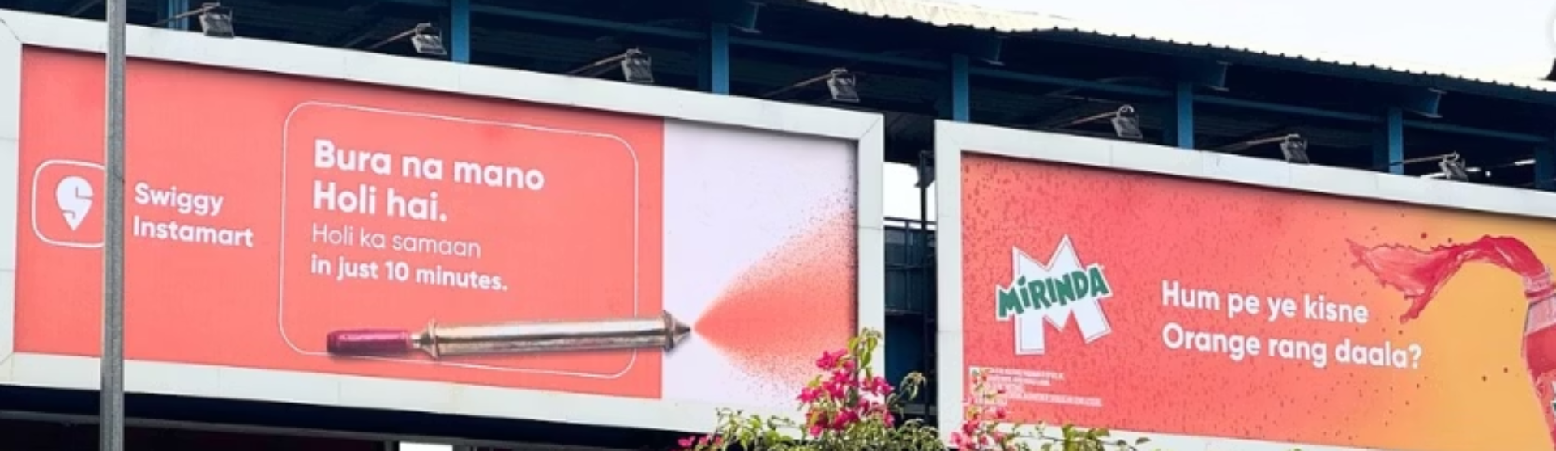
India’s "Instant" Economy
Building Brands at the Speed of Delivery: Growth Playbook
Logo

Slide 2

Logo
Executive Summary
Quick commerce is reshaping urban retail with ultrafast delivery and hyperlocal fulfillment.
Key players: Blinkit, Instamart, Zepto, etc., scaling rapidly with growing GMV and store counts.
Brands need actionable market intelligence to thrive in this dynamic environment.
This deck outlines QCom landscape, brand aspirations, key metrics, and how Firm X can empower brands.

Slide 3

Logo
Fast, Fresh, Now: QCom Revolution
What is Quick Commerce?
Ultrafast delivery (often 10-30 mins) of daily essentials. Operating via dark stores, cloud kitchens, or marketplace models. Highly focused on convenience, impulse buying, and fresh product availability. Differs from traditional e-commerce by speed, assortment, and local focus.
Growth Trend:
Quick commerce is of the fastest-growing e-retail segments, growing at 75–85% annually and captured over two-thirds of e-grocery orders in 2024. With a projected GMV of $5B by 2025, it signals a major transformation in India’s retail landscape.
Notes:
use theme 1DS

Slide 4



Logo
Top QCom Players & The Expansion Strategies
Blinkit
Swiggy Instamart
Zepto
Concentrates 80% of new stores in India's top 10 cities, prioritizing density over geographical spread.
Targeting tier-2/3 cities, expanding to 124 locations despite 68% of GOV still coming from metros.
Focused on optimizing existing stores rather than maximal expansion.
Current stores: 1,301 (Q4 FY25)
Current stores: 1,021 (Q4 FY25)
Current stores: 750
Expansion pace: 300+ stores/quarter since 2024
Q4 FY25 additions: 316 stores
Expansion target: 1,200 by March 2025
Cash burn: ₹1,488 crore in 90 days
Target: 2,000 stores by December 2025
EBITDA positivity: 75% of stores profitable

Slide 5









Logo
Category Diversification Strategies
Groceries
Electronics
60-65% of Blinkit's GMV, 55-60% of Instamart's, and 70% of Zepto's comes from grocery categories.
From mobile accessories to premium tech like iPhones, with Zepto dominating premium tech segment.
General Merchandise
Apparel
Platforms targeting 35-40% non-food GMV by 2026 to leverage 18-23% higher margins versus 8-12% in staples.
Blinkit focuses on essentials, Instamart on branded fashion, and Zepto on curated lifestyle collections.

Slide 6
Logo
Market Size and Growth Trajectory
75-85%
$5B
2/3
Annual Growth
Expected GMV
E-Grocery Share
Significantly outpaces traditional retail growth in the low teens
Projected market value by 2025
Portion of all e-grocery orders occurring on quick commerce platforms

Slide 7








Logo
Key Metrics for Brands to Track
Digital Shelf & Visibility Metrics
Operational Metrics
Share of Search/Visibility
Impressions and Click-Through Rate
Availability/Stock-Out Rate
Sales and Conversion Metrics
Fill Rate
Customer Metrics
Gross Merchandise Value (GMV)
Sponsored Banner Performance
Inventory Accuracy
Repeat Purchase Rate
Transaction Time
Customer Acquisition Cost (CAC)
Sales Conversion Rate
Average Order Value (AOV)
Customer Lifetime Value (CLV)
Top Products by Units Sold
Customer Satisfaction (CSAT)

Slide 8

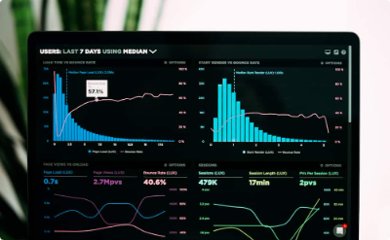


Logo
Market Intelligence Framework
Real-Time/Daily Monitoring
Weekly Reviews
Monthly Deep Dives
Annual Strategic Review
Evaluate sales trends, promotions, competitor activity, and inventory health.
Analyze category performance, customer segments, and benchmarks.
Assess overall strategy, market positioning, and alignment with goals.
Track stock, pricing, order fulfillment, and ad performance continuously.

Slide 9





Logo
[Firm X]: Driving Scalable Growth
Hyper-Accurate Demand Forecasting
Ensuring products are always available at the right PIN code and dark store. Out-of-stock means lost sales and lower platform ranking.
Personalized Recommendations
Offering the right pack sizes for different consumption occasions, as smaller pack sizes and single-use formats outperform bulk SKUs in quick commerce.
Dynamic, Intelligent Pricing
Continuously monitoring competitor pricing, discounting trends, and local demand elasticity to implement dynamic pricing strategies at the SKU level.
Real-Time Competitive Intelligence
Tracking and optimizing share of search, content completeness, and product ratings to improve visibility and conversion.

Slide 10
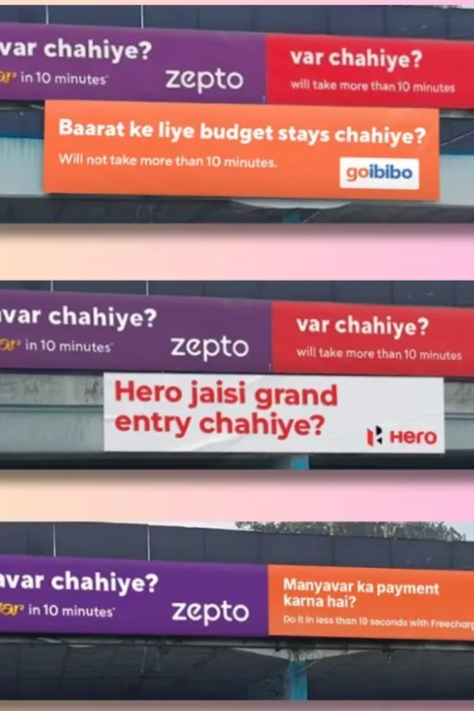
Logo
Core Growth Principles
Sizing
Availability
Optimize pack sizes for different consumption occasions and local preferences
Ensure products are always available at the right PIN code and dark store
Marketing
Pricing
Build meaningful difference and increase penetration through targeted campaigns
Set optimal price points that maximize conversion without eroding margin
Notes:
The core growth principles we'll cover today are availability, sizing, pricing, and marketing. Ensuring product availability at the right locations is crucial for growth. We need to make sure our products are stocked in the right pin codes and dark stores. Optimizing pack sizes for different consumption occasions and local preferences will help us meet customer needs more effectively. Setting the right price points is key - we want to maximize conversion without eroding margins. Building meaningful differentiation and increasing penetration through targeted marketing campaigns will drive awareness and trial of our products. These four principles - availability, sizing, pricing, and marketing - form the foundation of our growth strategy.

Slide 11








Logo
Strategic Recommendations for Brand Growth
Optimize Visibility
Increase Penetration
Maximize product placement in high-traffic zones and top search results
Focus on reaching more customers to drive long-term profitability
Continuous Iteration
Leverage Data
Test, learn, and optimize across all aspects of your quick commerce strategy
Use hyper-local insights to tailor strategies at PIN code level

Slide 12
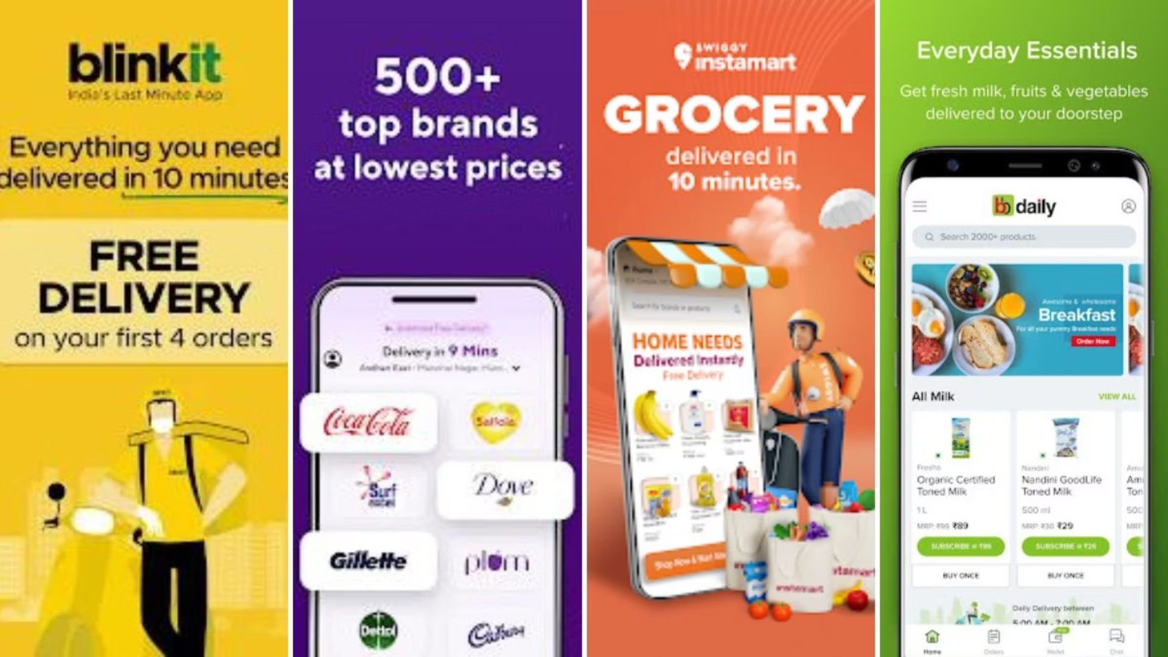
Logo
Research Links:
https://www.business-standard.com/industry/news/quick-commerce-sector-to-grow-75-85-in-2025-reach-5-billion-gmv-125031300389_1.html
https://www.blueweaveconsulting.com/report/india-quick-commerce-market https://razorpay.com/learn/data-analytics-in-marketing-guide/?website=%2Fpayroll%2Flearn%2Fflexible-benefit-plan-fbp-component%2F
https://www.business-standard.com/companies/start-ups/blinkit-instamart-zepto-witness-sharp-gov-surge-in-quick-commerce-125011600910_1.html
https://economictimes.com/tech/startups/swiggy-instamart-delivers-101-yoy-growth-in-q4-gov-loss-doubles/articleshow/121032517.cms
https://thefederal.com/category/business/quick-commerce-captures-two-thirds-of-e-grocery-orders-in-2024-report-178705
https://www.financialexpress.com/market/zepto-fy24-revenue-more-than-doubles-to-rs-4454-crore-losses-shrink-2-3691370/
https://www.ndtvprofit.com/business/quick-commerce-drives-two-thirds-of-e-grocery-orders-in-2024 https://www.salesforce.com/in/blog/market-penetration-guide/
https://indusfood.co.in/article/quick-commerce-in-india-transforming-the-food-delivery-landscape/
https://timesofindia.indiatimes.com/city/pune/the-rise-of-quick-commerce-from-groceries-to-iphones-consumers-embrace-instant-shopping/articleshow/113971859.cms
https://www.bigcommerce.com/articles/ecommerce/ecommerce-metrics/ https://www.mfilterit.com/blog/brand-can-optimize-quick-commerce-performance/
https://www.actowizsolutions.com/quick-commerce-data-intelligence-services.php https://www.shopify.com/sg/blog/basic-ecommerce-metrics
https://www.businessworld.in/article/quick-commerce-to-become-5bn-opportunity-by-2025-redseer-398049
https://digitalschoolofmarketing.co.za/blog/how-often-should-a-marketing-strategy-be-reviewed-and-updated/
https://thegood.com/insights/ecommerce-metrics/ https://aaronhall.com/how-to-use-market-data-to-inform-business-strategy/ https://1digitalstack.ai/how-to-build-a-brand-on-quick-commerce/
https://www.askattest.com/blog/articles/strategies-youll-want-to-steal-23-brand-growth-strategy-examples
https://fastercapital.com/topics/how-to-optimize-your-product-placement-strategy-for-maximum-brand-awareness.html https://www.investopedia.com/terms/m/market-penetration.asp

Slide 13
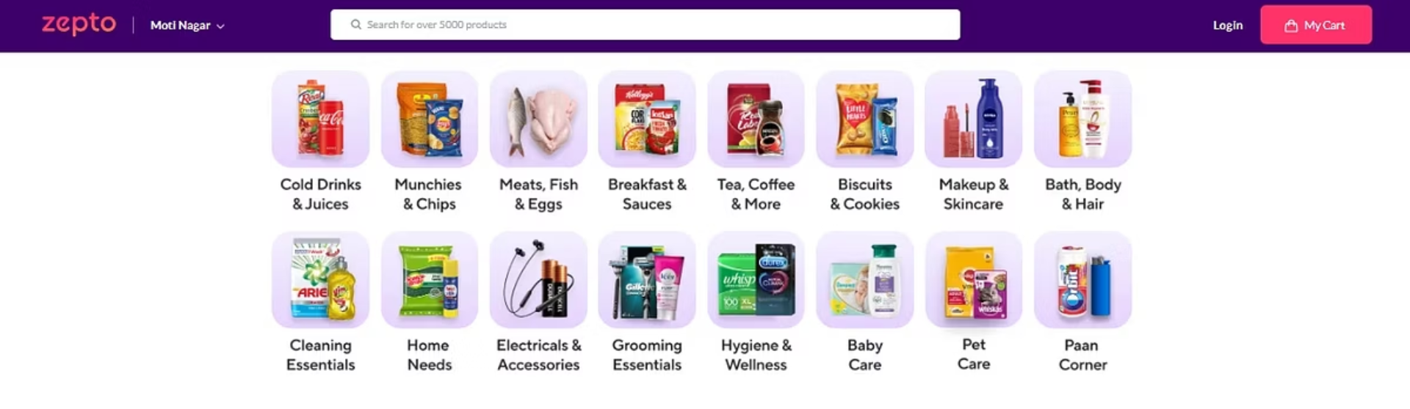
Thank You!
Name: Radha Singh | Application: Founder’s Office Role

